Slide 1
Open JTS – Juniper Telemetry Stack
09/2023 - David Roy – TME MX

Slide 2
Legal Disclaimer
Juniper may disclose information related to their development and plans for future products, features or enhancements ("SOPD"). SOPD information is subject to change at any time, without notice. Except as may be set forth in definitive agreements for the potential transaction, Juniper provides no assurances, and assumes no responsibility, that future products, features or enhancements will be introduced. Except as may be set forth in definitive agreements for the potential transaction, Company should not base purchasing decisions upon reliance of timeframes or specifics outlined in an SOPD, because Juniper may delay or never introduce the future products, features or enhancements.

Slide 3

Why Telemetry ?
SNMP
Collect mode: PULL
Transport Layer: IP / UDP (not reliable)
Port: 161
Application layer: SNMPv1; v2 or v3
Data model: MIB proprietary or standardized
Data format: SMI / ASN-1
Timestamp: Set by collector
Encoding : BER
Security: Community or key with SNMPv3
TELEMETRY gRPC
Collect mode: PUSH - STREAM
Transport Layer: IP / TCP (reliable)
Port : 9339 (configurable)
Application layer: HTTP/2 gRPC
Data model: Vendor specific or Vendor Neutral
Data format: YANG
Timestamp: Set by the router (even LC)
Encoding : ProtoBuf (GPB) or JSON
Security: login/pwd & TLS certificate
AND LAST BUT NOT THE LEAST
MOST OF THE NEW COUNTERS ARE ONLY AVAILABLE VIA TELEMETRY

Slide 4
Juniper supports many sensors…
BGP
SENSOR
OTN
SENSOR
Hardware
SENSOR
Segment
Routing
SENSOR
Power Usage
SENSOR
AND MANY OTHERS
SENSOR
PFE
SENSOR
BNG
SENSOR
Fabric
SENSOR
RSVP
SENSOR
Chassis inventory
SENSOR
IGP
SENSOR
NPU
SENSOR
Visit: https://apps.juniper.net/ydm-explorer/

Slide 5
Juniper Initiative Help our customers to discover the power of the Juniper Streaming Telemetry
OpenJTS
Juniper Telemetry Stack
A Reboot of the OpenNTI Opensource project but with more features:
Provide a complete/integrated/simple solution to quickly discover/test the power of Juniper Telemetry Interface
Build around several OpenSource Tools and some Juniper development.
For lab/pre-production
Help discovering Juniper Telemetry Power for the routing portofolio: ACX, MX, PTX and probably more in a second phase
Deploy in one command: Telemetry up and running in few minutes - easy to use!
Shipped with pre-defined templates and dashbords: nothing to do!
Easy to evolve – New profiles will be added during the time
New Code Name for this OpenSource initiative:

Slide 6
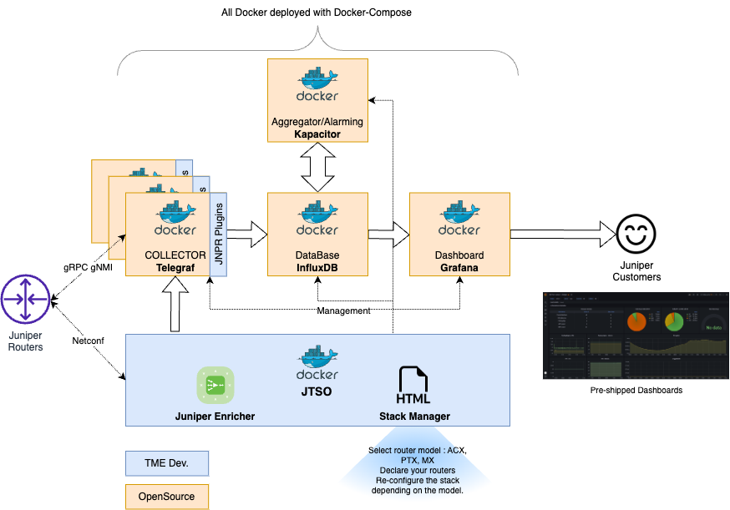
OpenJTS Architecture
90% OpenSource Tools
10% Juniper dev.

Slide 7
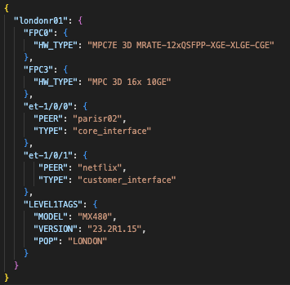

JTS Enricher
Automatic Enricher base on Netconf
Collect well-known « show » command
Format output in JSON files that will be injested by the Telemetry collectors: help to enrich on-the-fly telemetry data. JSON file maybe also modified with additionnal data by third party tool.
TELEGRAF (Telemetry Collector)
Timestamp: 2023-10-18T09:09:25.12Z
Tags:
if_name: et-1/0/0
device: londonr01
Fields:
in_octets = 1500515
out_octets = 1544156165
GNMI
Input Plugin
KPI
Rename Plugin
Enricher
Plugin
Output Influxdb Plugin
From Routers
To DB
Timestamp: 2023-10-18T09:09:25.12Z
Tags:
if_name: et-1/0/0
device: londonr01
PEER: parisr02
TYPE: core_interface
MODEL: MX480
VERSION: 23.2R1.15
POP: LONDON
Fields:
in_octets = 1500515
out_octets = 1544156165
Auto-Generated by the JTS ENRICHER
Juniper
Dev.

Slide 8
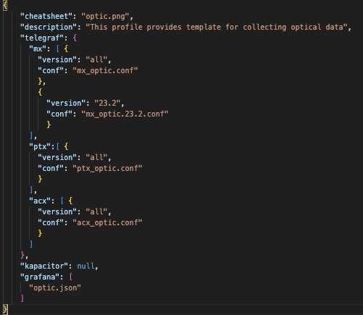
JTS Profile What is a profile?
myname.tgz
Collector config files
(telegraf)
Collector config files
(telegraf)
Collector config files
(telegraf)
definition.json
Collector config files
(telegraf)
Collector config files
(telegraf)
Collector config files
(telegraf)
Collector config files
(Telegraf)
Tick Scripts
(Kapacitor)
Dashboard
(Grafana)
definition.json
Just a TGZ file including several files.
Must follow naming convention
Design Guide to let anybody make his own profile will be provided.
Easy to evolve… Adding profiles without touching the code…

Slide 9
OpenJTS up and running
Steps to play with OpenJTS:
Enable gRPC and Netconf services
git clone https://xxxxxxxx/jts
docker compose up -d
Go to http://xxxxx/jtso.html
Fill your routers IP/Name/Credentials info
Assign a pre-defined profile to your routers:
Optical monitoring profile
Health monitoring profile
Traffic & CoS monitoring profile
BGP monitoring profile
…
Use pre-shipped Grafana Dashboard
Enjoy your KPI and That’s all….

Slide 10
Simple User Guide Step 1: configure your router(s) - do it only one time
# Netconf User
set system login user netconf_user class super-user
set system login user netconf_user authentication encrypted-password “”
#gNMI User
set system login user gnmi_user class super-user
set system login user gnmi_user authentication encrypted-password “”
# Clear Text gRPC
set system services extension-service request-response grpc clear-text port 9339
set system services extension-service request-response grpc max-connections 8
set system services extension-service request-response grpc skip-authentication
# Or TLS encryption gRPC
set system services extension-service request-response grpc ssl port 9339
set system services extension-service request-response grpc ssl local-certificate lcert
set system services extension-service request-response grpc ssl mutual-authentication certificate-authority ca1
set system services extension-service request-response grpc ssl mutual-authentication client-certificate-request require-certificate-and-verify
# Netconf
set system services netconf ssh
set system services netconf rfc-compliant #optional

Slide 11
Simple User Guide Step 2: Install & Run the stack
Do it only one time
dave@ubuntu-02:~$ mkdir -p /opt/JTS
dave@ubuntu-02:$ cd /opt/JTS
dave@ubuntu-02:/opt/JTS$ git clone https://door7302@xxxxxxxxxxxxxxxxx/jts.git .
dave@ubuntu-02:/opt/JTS$ cd compose
dave@ubuntu-02:/opt/JTS/compose$ docker compose up –d
[+] Running 8/8
✔ Network compose_default Created
✔ Container influxdb Started
✔ Container jtso Started
✔ Container grafana Started
✔ Container kapacitor Started
✔ Container telegraf_ptx Started
✔ Container telegraf_mx Started
✔ Container telegraf_acx Started
First Time it takes 5 minutes due to Telegraf & JTSO compilation
Then it takes 5 seconds to start
Tunning available in the install guide

Slide 12
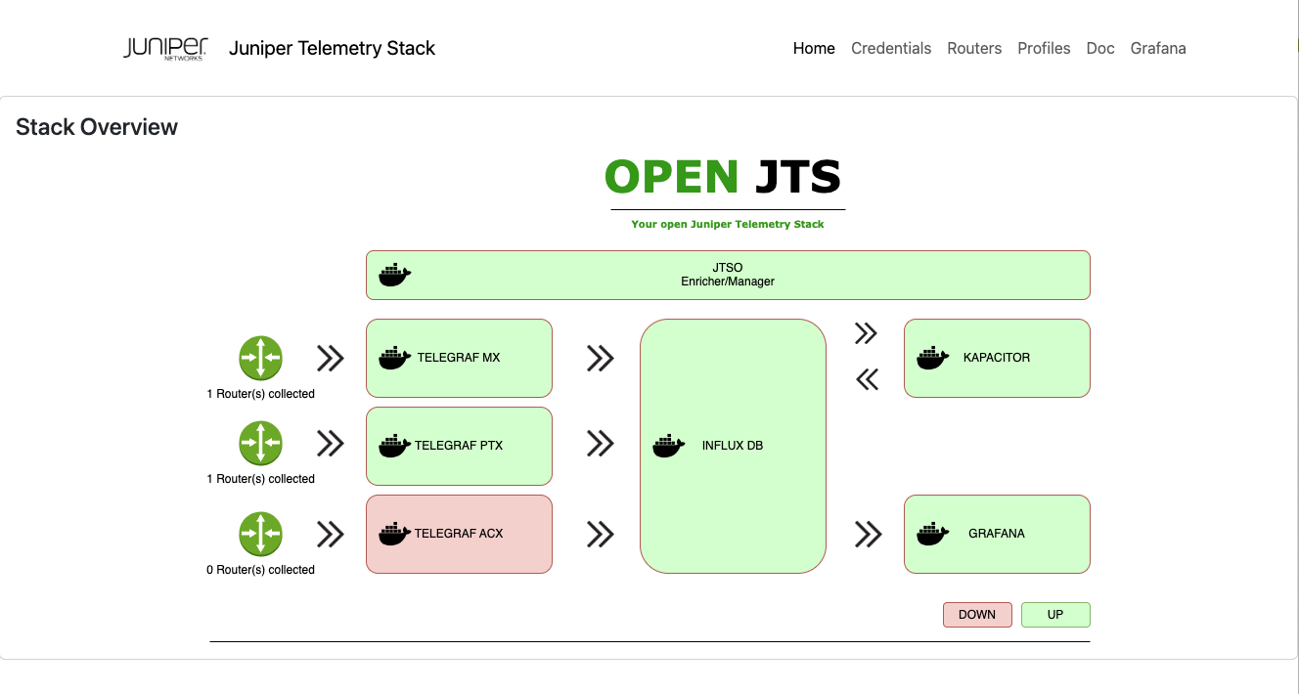
Simple User Guide Step 3: Configure JTSO – Stack state
HTTP & HTTPS Access

Slide 13
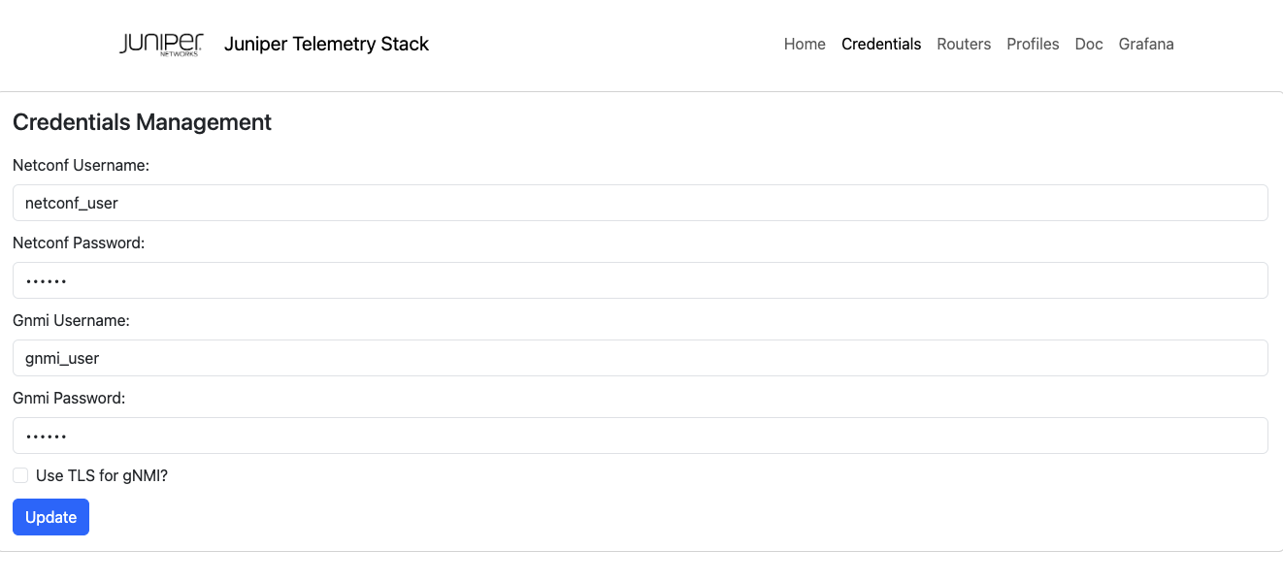
Simple User Guide Step 3: Configure JTSO – Set your credentials - gRPC encryption

Slide 14
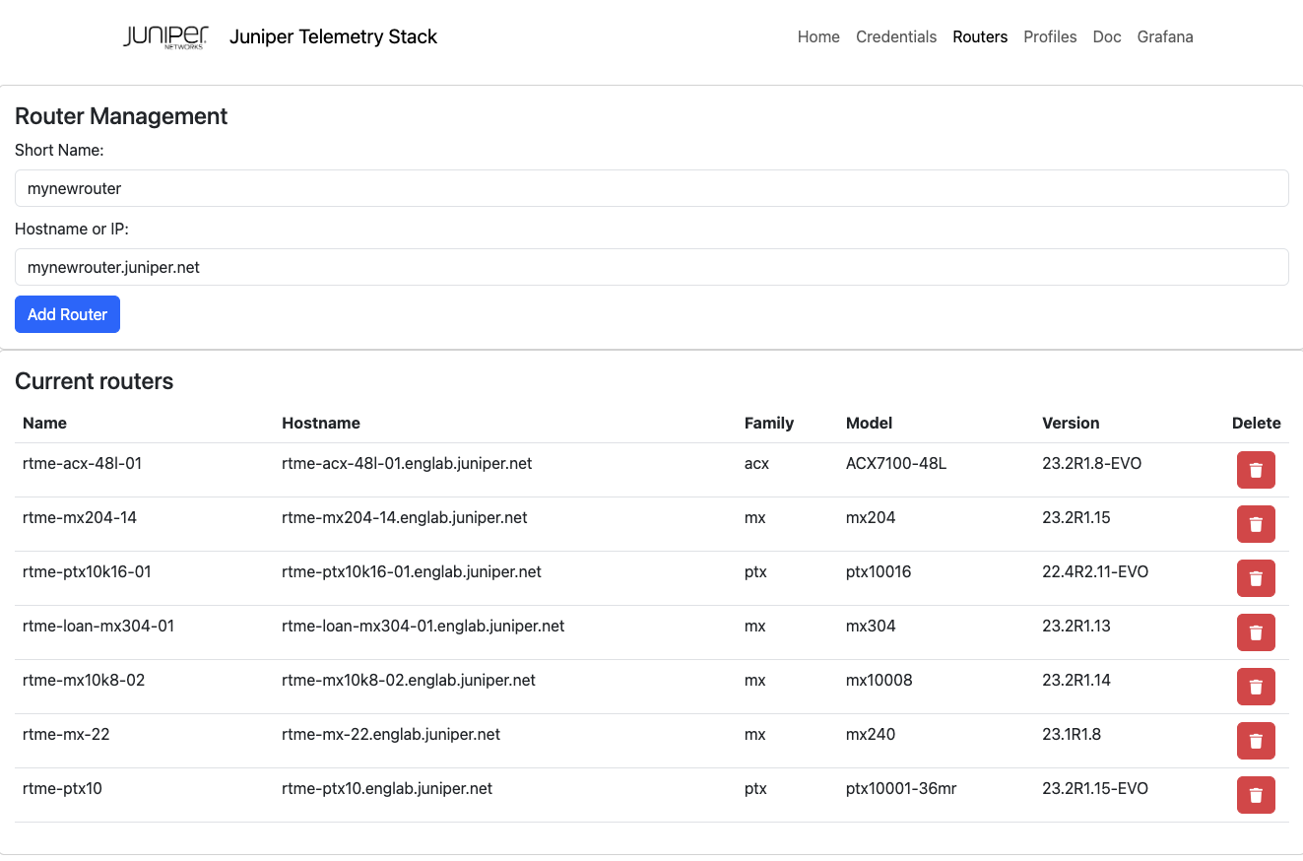
Simple User Guide Step 3: Configure JTSO – Add router(s) to inventory
Auto discovery (Netconf) of the family, model and version

Slide 15
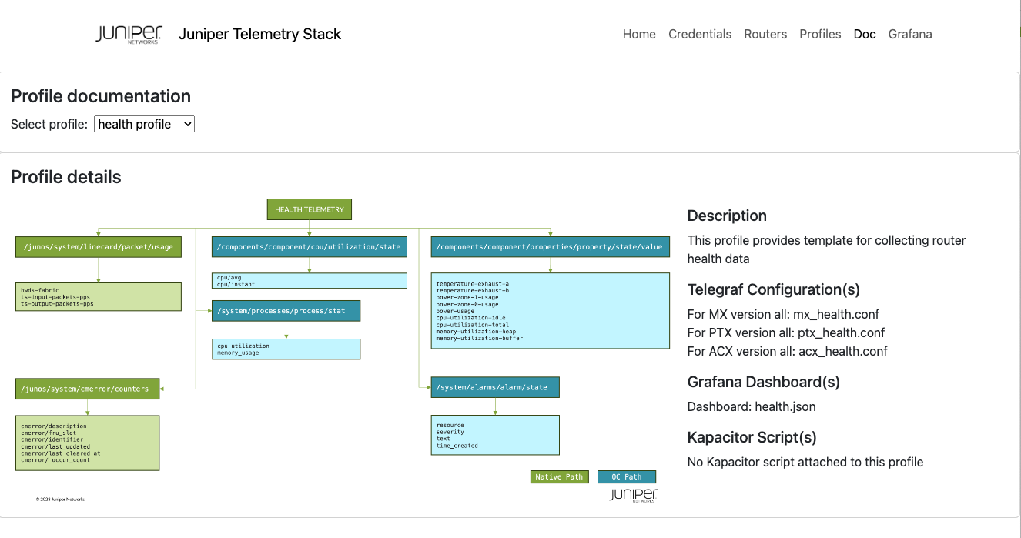
Simple User Guide Step 4: Access to profile doc

Slide 16
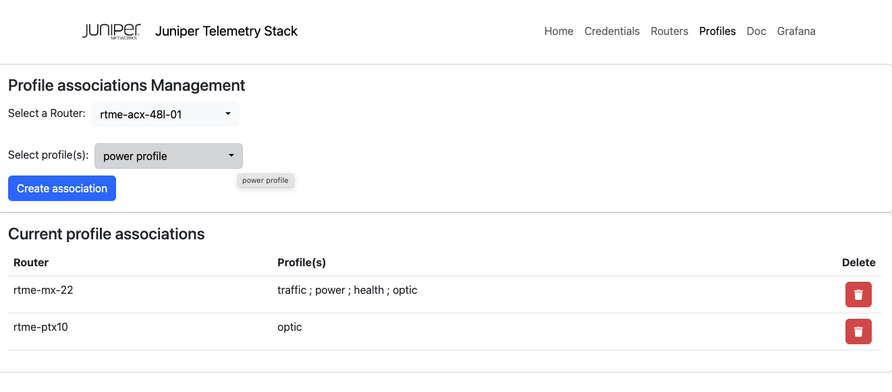
Simple User Guide Step 5: Assign router(s) to profile(s)
Stack is automatically reconfigured – collect started/stopped

Slide 17
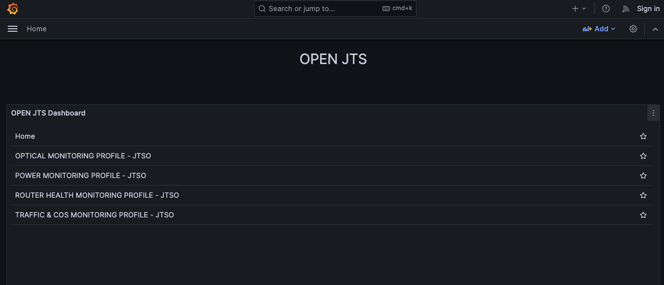
Simple User Guide Step 6: Access to Grafana Home
HTTP & HTTPS Access
Dynamically updated depending on the active profile(s)

Slide 18
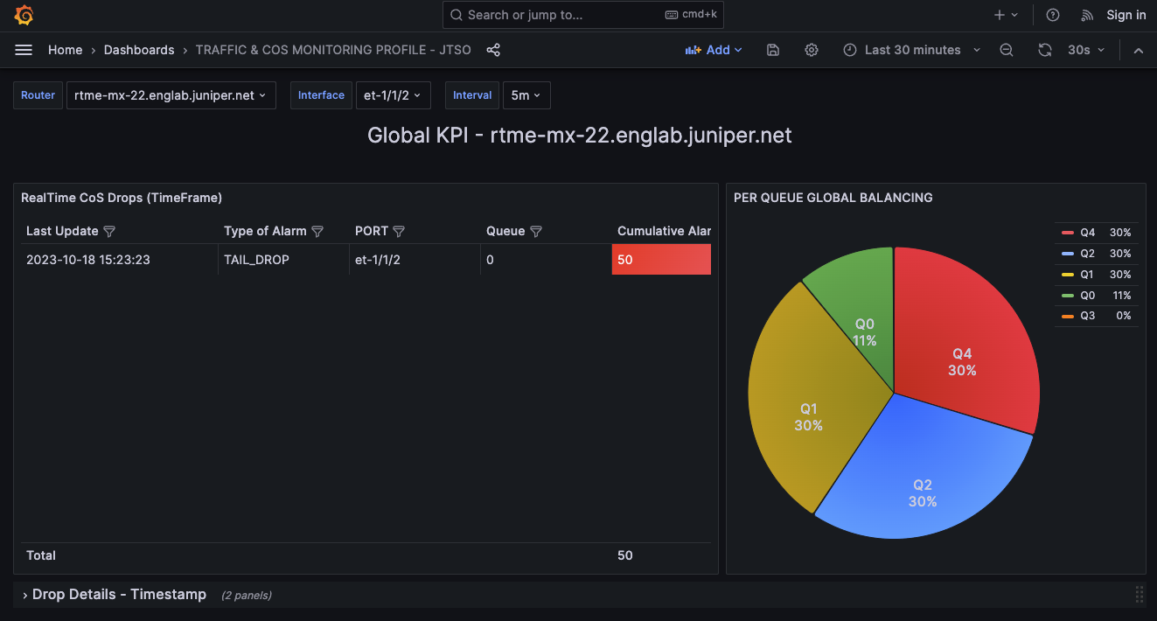
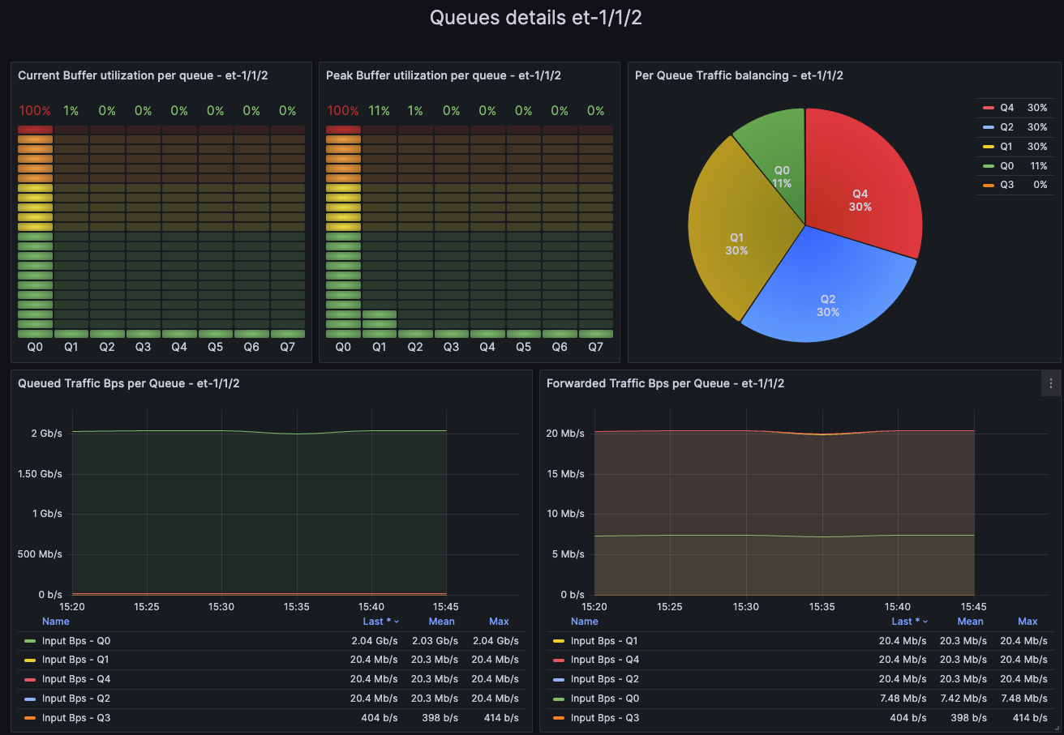
Simple User Guide Step 7: Enjoy pre-shipped Dahboards

